Slide 1


Advantages of AI Branding
Start here

Slide 2

Introduction
AI-generated branding offers startups and small businesses an innovative way to establish their identity. By leveraging advanced technologies, these businesses can enhance their brand presence and create memorable experiences. In this presentation, we will explore the significant benefits that AI branding brings to the table.

Slide 3
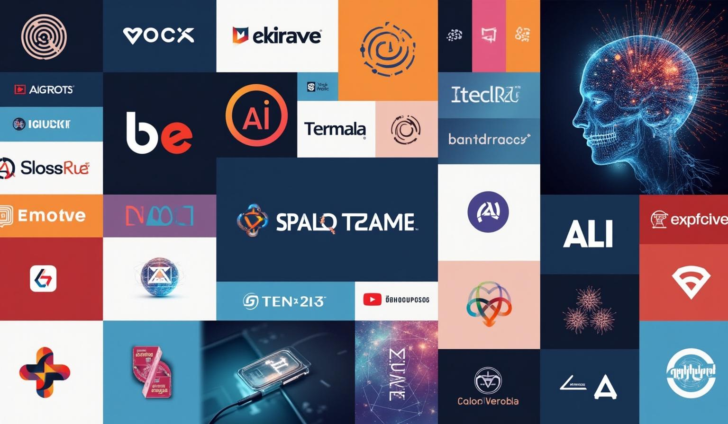
Benefits of AI-Generated Branding
01

Slide 4

Cost Efficiency
AI branding significantly reduces expenses associated with traditional branding methods. By automating design processes, startups can allocate funds more effectively toward growth and innovation.

Slide 5
Time Savings
With AI-driven tools, the branding process is expedited, allowing startups to bring their products to market quicker. This efficiency transforms ideas into reality swiftly, enabling entrepreneurs to focus on their core business operations.

Slide 6
Customization and Scalability
AI branding solutions allow startups to create unique brand identities that can grow with their business. These tools enable consistent branding across all platforms, while also offering the flexibility to adapt as the market evolves. This scalability ensures that as your business expands, your branding can effortlessly keep pace.

Slide 7

Enhanced Brand Identity
02

Slide 8
Consistent Visuals
AI tools maintain a cohesive visual identity that resonates with target audiences. By ensuring uniformity in design elements, businesses can build trust and recognition in their branding, leading to stronger customer loyalty.

Slide 9
Tailored Messaging
AI-driven analytics provide insights into customer preferences, allowing startups to craft personalized messaging. This tailored approach enhances engagement and fosters a deeper connection with the audience, elevating brand perception.

Slide 10

Data-Driven Insights
Utilizing AI means you can analyze vast amounts of data to inform branding decisions, ensuring strategies are effective and targeted. These insights empower startups to align their branding with customer expectations, leading to increased market relevance.

Slide 11

Conclusions
AI-generated branding provides immense advantages for startups and small businesses. From cost savings to the ability to generate customized and relevant branding strategies, AI is a game changer. Embrace these innovations to stand out in a competitive landscape and transform your brand journey into a compelling success story.

Slide 12
Thank you!
Do you have any questions?
+00 000 000 000

